Slide 1
MLDA
Multi-typed objects Multi-view Multi-instance Multi-label Learning
Yuanlin Yang^{1,2}, Guoxian Yu^{1,2,3,*},Jun Wang^{1,2}, Carlotta Domeniconi⁴ and Xiangliang Zhang³
¹Southwest University, Chongqing, China
²Shandong University, Jinan, China
³King Abdullah University of Science and Technology, Thuwal, SA
⁴George Mason University, VA, USA
Machine Learning and Data Analysis Lab
*www.mlda.swu.edu.cn (gxyu@sdu.edu.cn)
Notes:
Hello everyone , I am Yuanlin Yang . the first author off the paper , My tittle is Multi-typed objects Multi-view Multi-instance Multi-label Learning. When reading the title you may be wondering what am I going to talk about. Let’s start.

Slide 2
1
Introduction
2
Related works
CONTENTS
3
M4L-JMF
4
Results
Notes:
Our prestantetion is divided into 4 parts.

Slide 3
Background
Traditional setting :
sample instance +label
Multi-intance setting :
complex object multi-instance + label
VS traditional setting
More powerful and richer information to model
Zhou, Zhi-Hua, et al. "Multi-instance multi-label learning." Artificial Intelligence 176.1 (2012): 2291-2320.
Notes:
in the beginning ,we want to introduce some related background. For Traditional setting, a example composed with instance and label , but for Multi-intance setting, a example composed with multi- instance. Because multi- instance has more powerful and richer information to model

Slide 4
Background
Complex object
Multi-view Multi-instance Multi-label data
Import concept:
Bag are composed of multi-instance.
Instance represents heterogeneous feature vector .
Notes:
Before introducing (M4L), let me briefly introduce Multi-view Multi-instance Multi-label Learning M3L, The video in the picture can be regarded as a complex bag object. Then, since the video is composed of images and text, there are two views, namely text and image views. The text paragraph or picture inside is called instance.

Slide 5
M3L^{[1]}
Multi-view Multi-instance Multi-label Learning(M3L)
Purpose:
To obtain the label information of a sample by learning the feature of the instance contained in multiple views.
[1]Y. Xing, G. Yu, C. Domeniconi, J. Wang, Z. Zhang, and M. Guo, “Multi-view multi-instance multi-label learning based on collaborative matrixfactorization,” in AAAI , 2019, pp.5508–5515.
Notes:
Multi-view Multi-instance Multi-label Learning, M3L for short. This is bag object. Which composed with multi-instanc. This is instance,. The purpose of M3L is to To obtain the label information of a sample by learning the feature of the instance contained in multiple views.

Slide 6
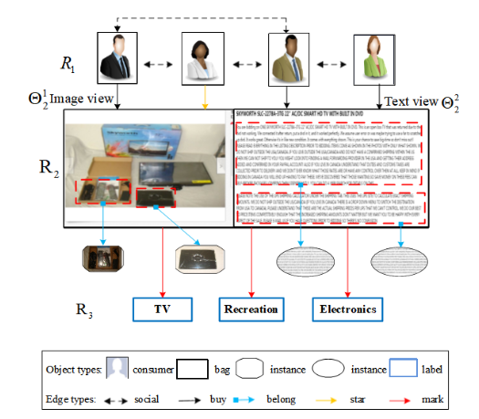
Challenges
聚类算法具备的二要素
Challenge 1:
M3L lacks the capability to simultaneously model multi-typed objects.
Challenge 2:
Data Fusion(DF) solution consider multi-typed object, but ignores the important bag-instance relation.
Challenge 3:
How to extend the M3 scenario to the more generic and powerful M4 scenario.
Fig.3 An illustration of the M4 (Multi-typed objects
Multi-view Multi-instance Multi-label) data with two types
of objects (customers R₁ and goods R₂).
Notes:
There are three challenges, first, M3L lacks the capability to model multi-typed objects. For M3, consumer type objects are not considered . Second, Data Fusion(DF) solution consider multi-typed object, but ignores the important bag-instance relation. Thirdly, How to extend the M3 scenario to the more generic and powerful M4 scenario.

Slide 7
Related works
聚类算法具备的二要素
Data Fusion （DF）Solution based on Matrix Factorization:
reconstruct the target relational matrix to predict
the relations between multi-typed object
DFMF^{[1]}
[2] and [3] consider the different relevance of multiple
inter(intra)-relational block matrices toward the target
prediction task and selectively fused these block data source
MFLDA^{[2]}
WMFLDA^{[3]}
Multi-view Multi-instanceMulti-label Learning
M3LDA^{[4]}
They focus on the import bag instance relation and model with
different aspects, then predict the bag/instance-label.
M3Lcmf^{[5]}
M3Lmix^{[6]}
[1]Žitnik M, Zupan B. Data fusion by matrix factorization. IEEE TPAMI, 2014, 37(1): 41-53.
[2]G. Fu , et. al. Matrix factorization-based data fusion for the prediction of lncrna–disease associations, Bioinformatics, 2018.
[3] Wang, G. Yu, et. al. Weightedmatrix factorization on multi-relational data for lncrna-disease associa-tion prediction, Methods, 2020
[4]Nguyen C T, et. al. Multi-modal image annotation with multi-instance multi-label LDA, IJCAI , 2013.
[5]Yuying Xing, et. al. Multi-View Multi-Instance Multi-Label Learning Based on Collaborative Matrix Factorization. AAAI, 2019.
[6] Cam-Tu Nguyen, Xiaoliang Wang, Jing Liu, and Zhi-Hua Zhou. Labeling complicated objects: Multi-view multi-instance multi-label learning. AAAI, 2014.
Notes:
DFMF reconstruct the target relational matrix to predict the relations between multi-typed object. MFLDA and WMFLDA consider the different relevance of multiple inter(intra)-relational block matrices toward the target prediction task and selectively fused these block data.

Slide 8
Related works
聚类算法具备的二要素
Data fusion solution based on matrix factorization:
DFMF^{[1]}
The important bag-instance association is ignored.
MFLDA^{[2]}
WMFLDA^{[3]}
Multi-view Multi-instanceMulti-label Learning
M3LDA^{[4]}
The M3L-based method only considers single type of object.
M3Lcmf^{[5]}
M3Lmix^{[6]}
[1]Žitnik M, Zupan B. Data fusion by matrix factorization. IEEE TPAMI, 2014, 37(1): 41-53.
[2]G. Fu , et. al. Matrix factorization-based data fusion for the prediction of lncrna–disease associations, Bioinformatics, 2018.
[3] Wang, G. Yu, et. al. Weightedmatrix factorization on multi-relational data for lncrna-disease associa-tion prediction, Methods, 2020
[4]Nguyen C T, et. al. Multi-modal image annotation with multi-instance multi-label LDA, IJCAI , 2013.
[5]Yuying Xing, et. al. Multi-View Multi-Instance Multi-Label Learning Based on Collaborative Matrix Factorization. AAAI, 2019.
[6] Cam-Tu Nguyen, Xiaoliang Wang, Jing Liu, and Zhi-Hua Zhou. Labeling complicated objects: Multi-view multi-instance multi-label learning. AAAI, 2014.
Notes:
But also exist some problem , The important bag-instance association is ignored. Another one is that The M3L-based method only considers single type of object, it is not flexible to handle multiple objects, and does not distinguish the importance of different types of objects.

Slide 9
Basic idea
Multi-typed objects Multi-view Multi-instance Multi-label
Learning (M4L)
Purpose of M4L: By learning the multi-type object information of a sample in multi-views, capturing the intra- and inter-relation of multiple objects(minning more useful information), and distinguishing sub-objects (instacne). And then construct the instance (bag)-label relation for prediction task.
Idea: Joint Matrix Factorization based solution M4L-JMF, leverage multiple inter(intra)-relations between bags of different types, associations between bags and instances
Notes:
So we introduce M4L to solve the challenging problem. The idea is using a Joint Matrix Factorization based solution (namely, M4L-JMF), which can leverage multiple inter(intra)-relations between bags of different types, associations between bags and instances, and the label correlations to annotate the complex bag and its instances

Slide 10
Objective Function
: inter association matrix
: low-rank matrix
: can be regard as a compressed matrix, latent inter associations between object i and j
: intra association matrix
Factorization of the relation matrix of different typed objects
Aggregate object information in
multi-views
Reconstruct bag-instacne relation
Notes:
This is Objective Function, first term means factorization of the relation matrix of different typed objects. Second term aggregate object information in multi-views. And Third term is to reconstruct bag-instacne relation.

Slide 11
Objective Function
Distinguishing the importance of different data source
Distinguish the importance of the same typed object in different views
Notes:
W^r are added to distinguish the importance of different object, W^h Distinguish the importance of the same typed object in different views. Alpha ang beta is Hyperparameter

Slide 12
Experiments(M4L)
Datasets
M4: Isoform^{[1]}
Muti-typed objects: LncRNA^{[2]}
Evaluation Metrics
AvgF1： the average F1-score
AUROC：the average area under the receiver operating curve
AUPRC：average area under the precision-recall (PR) curve
[1] G. Yu, et. al. Isoform function prediction based on bi-random walks on a heterogeneous network, Bioinformatics, 2020.
[2] G. Fu , et. al. Matrix factorization-based data fusion for the prediction of lncrna–disease associations, Bioinformatics, 2018.
Notes:
we use ISoform and LncRNA datasets. this is related evalution metrics

Slide 13
Baselines
DF
M3L
DFMF[1]
MFLDA[2]
SNMTF[3]
M3Lcmf[4]
ICM2L[5]
M2IL[6]
[1]Žitnik M, Zupan B. Data fusion by matrix factorization. IEEE TPAMI, 2014.
[2]G. Fu , et. al. Matrix factorization-based data fusion for the prediction of lncrna–disease associations, Bioinformatics, 2018.
[3]H. Wang, H. Huang, and C. Ding, Simultaneous clustering of multi-type relational data via symmetric nonnegative matrix tri- factorization, CIKM, 2011.
[4]Yuying Xing, et. al. Multi-View Multi-Instance Multi-Label Learning Based on Collaborative Matrix Factorization. AAAI, 2019.
[5]Qiaoyu Tan, Guoxian Yu, Jun Wang, Carlotta Domeniconi, and Xiangliang Zhang. Individuality-and commonality-based multiview multilabel learning. IEEE T. on CYB, 2020.
[6]B. Li et al. Multi-View Multi-Instance Learning Based on Joint Sparse Representation and Multi-View Dictionary Learning, IEEE TPAMI, 2017.
Notes:
We compared with some related methods.
we run 5-fold cross validation for 10 independent rounds, and report the average results

Slide 14
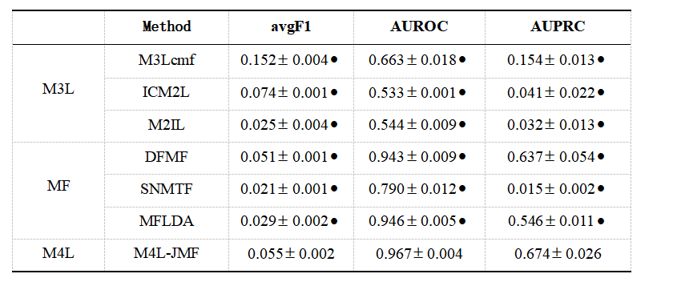
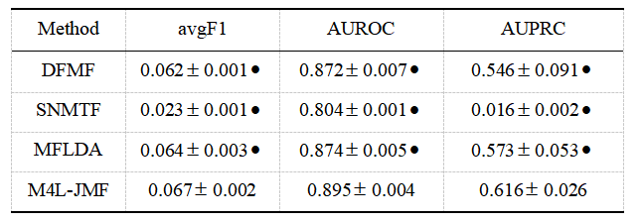
Experiments(M4L)
M4
Tabel I Results on Isoform dataset of M4L, M3L-based methods and matrix factorization(MF)-based methods by 5-fold cross validation.
Muti-typed objects
Tabel II Results of M4L-JMF and matrix factorization based methods on the LncRNA dataset.
Notes:
From obove result , we have the following important observations:
(i) Projection of multi-type objects along the target type causes information loss.
(ii)The bag-instance associations carry important information and can boost the performance of M4L.
(iii)Selective fusion of data can further boost the performance. M3Lcmf and DFMF simply add up all the inter(intra)-relational data matrices, without considering the different relevance of these data sources.

Slide 15
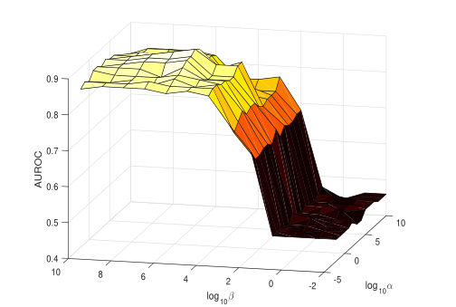
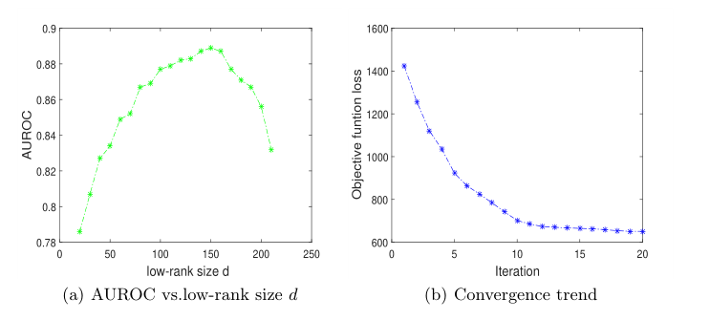
Experiments(M4L)
Parameter Sensitivity Analysis
AUROC of M4L-JMF under different settings of α and β on the LncRNA datase
Loss decreases as the iteration proceeds and comesto a convergence within 20 iterations
Notes:
Too small d can not sufficiently encode the latent feature information of multi-type objects and labels, and while a too large d may bring in somenoises and thus leads to a low AUROC value.

Slide 16
Experiments(M4L)
Conclusion
(i) We study a new learning paradigm Multi-typed objects Multi-view Multi-instance Multi-label Learning (M4L)
(ii)We introduce a joint matrix factorization based solution M4L-JMF, which can leverage multiple inter(intra)-relations between bags of different types, associations between bags and instances, and the label correlations to annotate the complex bag and its instances.
Notes:
We study a new learning paradigm Multi-typed objects Multi-view Multi-instance Multi-label Learning (M4L), which is a universal framework learning on naturally interconnected multi-typed complex objects. This learning scenario is more general than studied M3L, which can only work with single-typed objects.
We introduce a joint matrix factorization based solutionM4L-JMF, which can leverage multiple inter(intra)-relations between bags of different types, associations between bags and instances, and the label correlations to annotate the complex bag and its instances.

Slide 17
Thank ICDM reviewers and Committee！

